Slide 1
How Can Olist Gain Market Share and Grow as a Retailer?
April 10 ^{th} 2019
Zachary Amar

Slide 2
Agenda
1
Introduction
Company Overview
Problem Statement
2
The Data
The Dataset, Data Cleaning & Modifications
Analytics Techniques Used
3
Our Customers
Geographical Distribution
Purchasing Profile
4
Recommendations
5
Conclusion

Slide 3
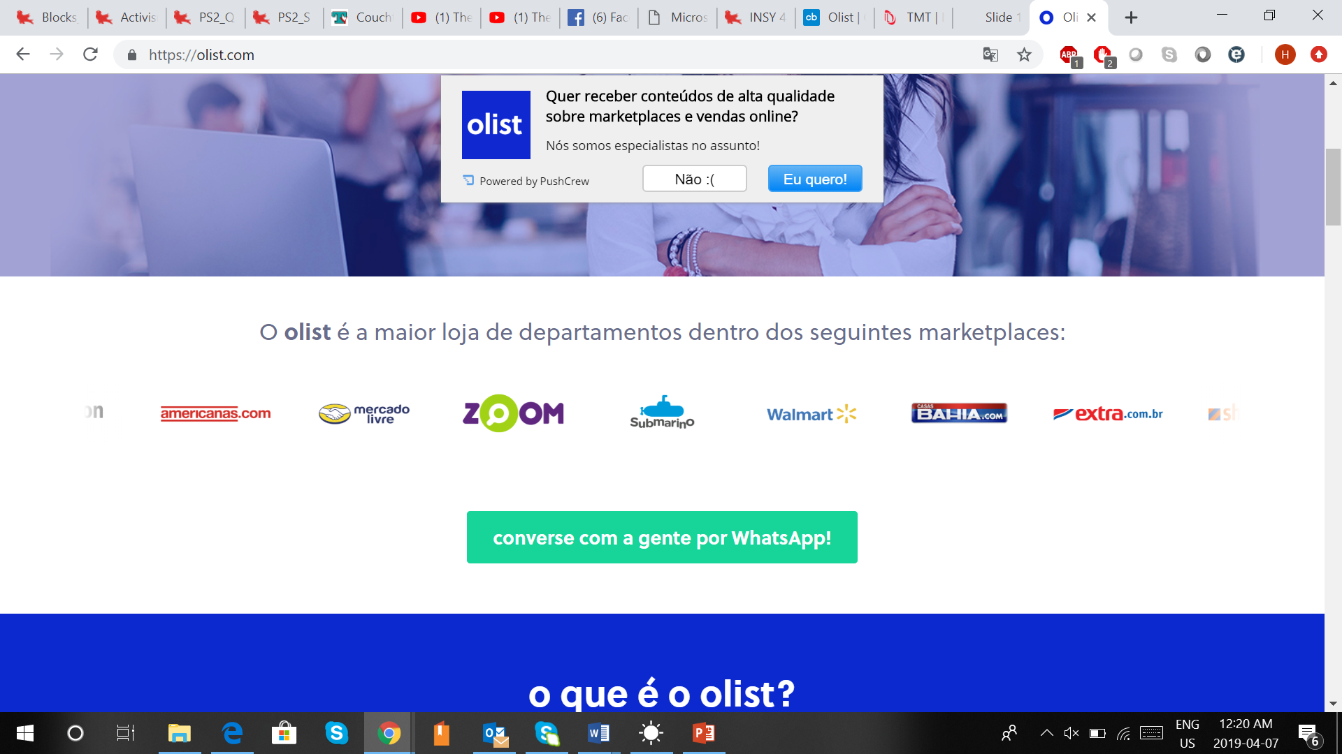
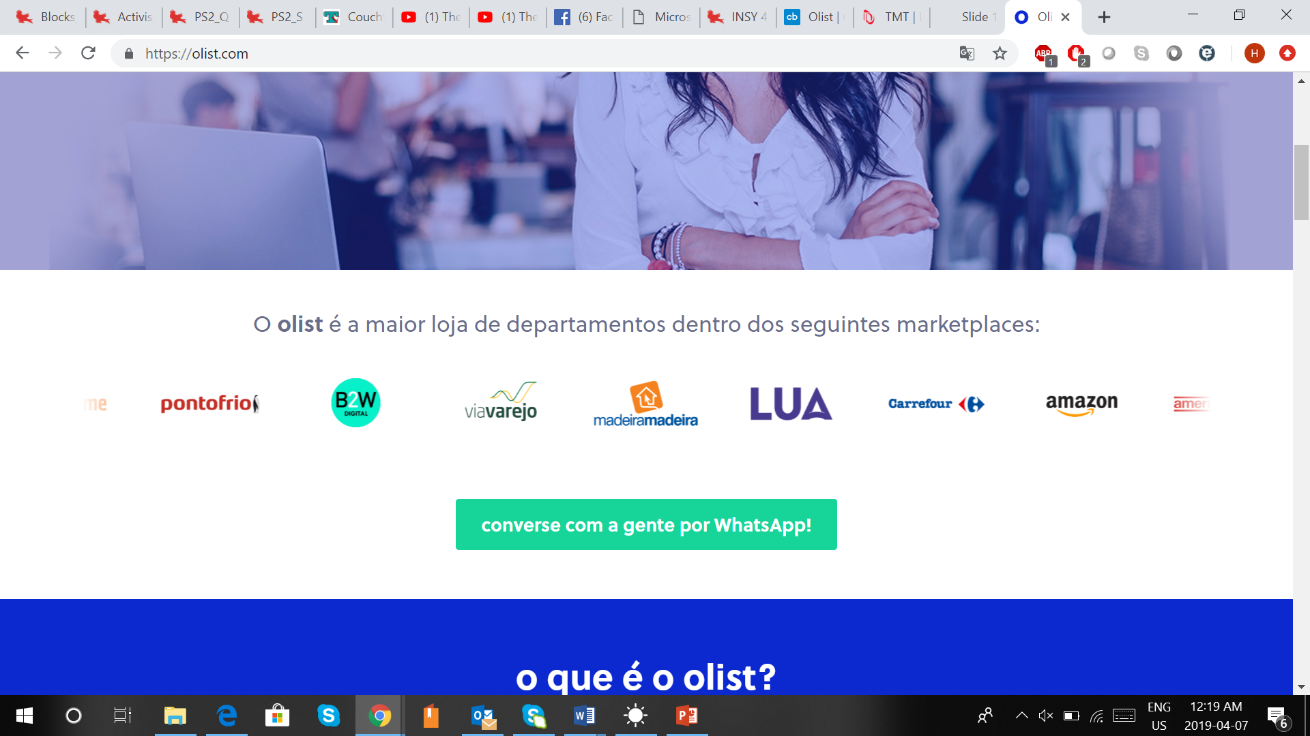
Introduction Company Overview
Overview
Overview
Year Founded: | 2015
Industry: | E-commerce
Business Segments: | E-commerce, SaaS, Retail
Current VC Funding | $8.8M
An online e-commerce marketplace located in Brazil, Parana, which offers a platform for thousands of retailers around the country to post their products.
Retailers serve as the distributors, with Olist connecting the retailers with the end customers through their online platform
Sample Brands

Slide 4
Introduction Problem Statement
We want to understand how to make Olist an even bigger retailer and avoid the threats of multinationals such as Amazon

Slide 5
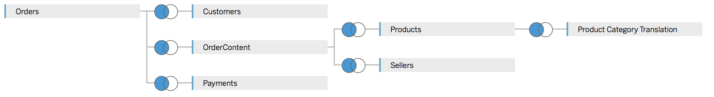
The Data Dataset, Data Cleaning & Data Modification
Data Tables
Data Cleaning
Data Modification
Measures Added
Date and Time columns created from the time date provided
Categories were checked, in order to make sure the same category did not appear twice with a slightly different name
Each column was converted to the correct type in order to avoid issues with format later
Only delivered orders kept
Flag created to identify active and inactive customers
Break down of delivery time into seller to carrier and carrier to customer
Flag to identify whether an order was on on time
Profits measure: looks at the profit per order
Olist % delivery time measure: looks at what % of the delivery time is represented by Seller2Carrier
On time performance measure: looks at what % of the deliveries arrived on time

Slide 6


The Data Techniques Used
Choice of Software
Analytical Methods
Excel was used for data modification due to the relative ease of manipulating tables and columns within it
Once we were satisfied with the data structure, we used Tableau to generate the aforementioned custom measures as it would be better able to integrate those measures into the desired visualization
Tableau was used to finally obtain the desired visualizations in the form of the various charts and graphs that will be displayed in this presentation

Slide 7
Our Customers

Slide 8
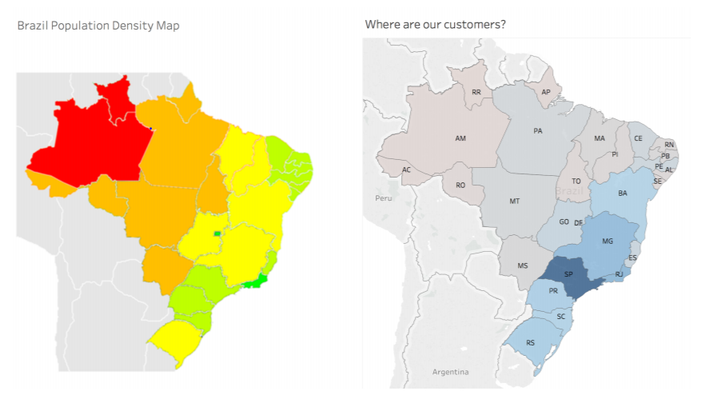
Who Are Our Customers? Location Distribution
2
1
Olist has strong presence in key metropolitan areas such as Rio de Janeiro and São Paulo
1
High population density area in the Northeast
2
This same area is underserved by Olist, thus indicating a potential expansion opportunity

Slide 9
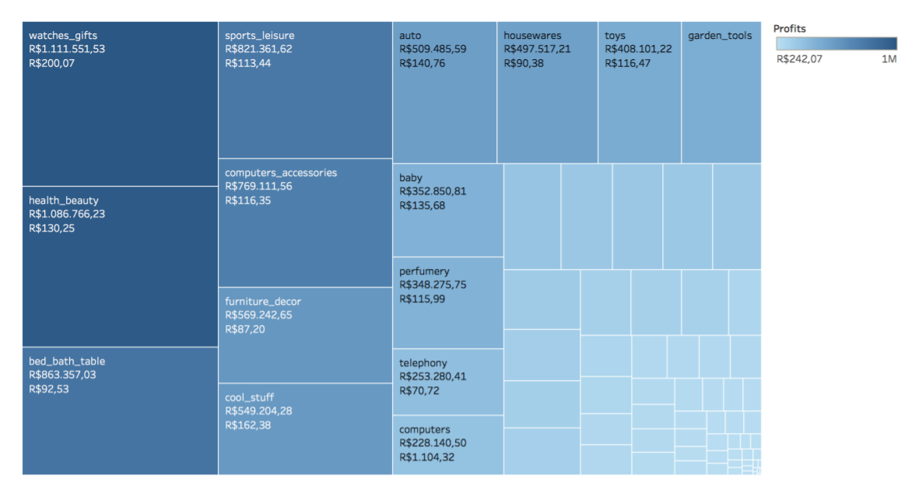
Who Are Our Customers? Purchasing Profile – Categories
1
Olist’s revenue stream is highly reliant on a small part of its catalogue, with over 50% of revenue coming from only 10 categories of articles. These high-selling products all enter a pattern of ‘big one-time purchases’, such as watches, furniture or housewares. These items are not usually ordered regularly by consumers.
1

Slide 10
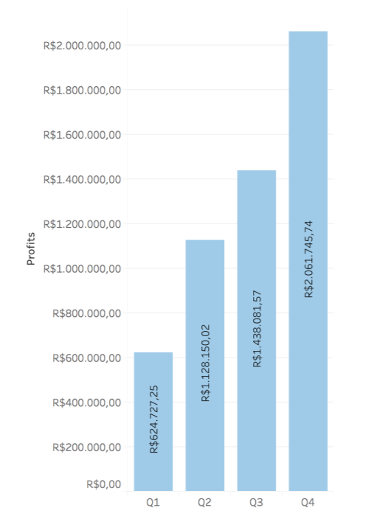
Who Are Our Customers? Purchasing Profile – Quarter of Purchase
The large difference in sales between Q2 and Q3 provide us with a potential business opportunity. Spring isn’t a time for big purchases, which make up most of Olist’s sales. A pivot to selling more household goods that are regular purchases for consumers could aid in increasing Q2 sales
1
2
1
Large Q4 sales can be attributed to the holiday season, and the subsequent Q1 drop is due to the fact that people want to reign in purchases after the holiday’s
2

Slide 11
Our Recommendations

Slide 12
Recommendation 1: Advertising
We believe advertising can allow Olist to gain revenues by making the orders on Olist more frequent rather than large one time purchases

Slide 13
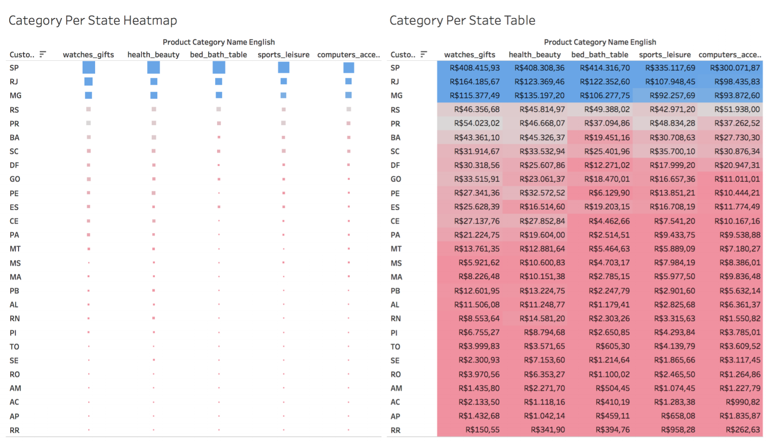
Recommendation 1: Advertising Revenues Per Category Per State
1
2

Slide 14
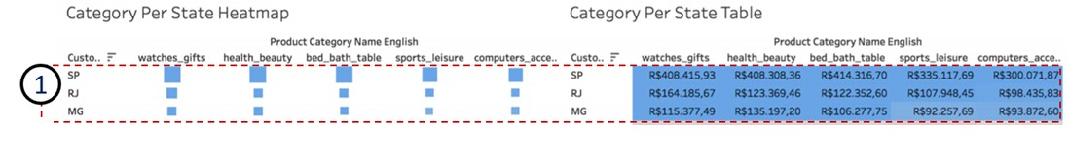
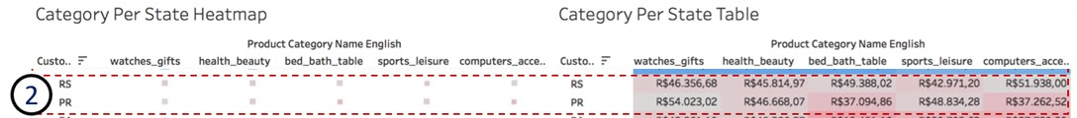
Recommendation 1: Where & How to Advertise? Revenues Per Category Per State
Top 3 states are Sao Paulo, Rio de Janeiro, and Minas Gerais
Have the same top 3 categories in the same order: watches, health & beauty products, and bed/bath table
For these large states, we recommend targeting high population areas with billboards, such as malls and beaches in order to maximise Olist brand exposure and to continue growing the customer base in theses states
The remaining states in the top 5 are Rio Grande do Sul and Parana, whose best-selling categories are computer accessories and watches respectively
For these less populated, smaller states we recommend a more targeted social media ad campaign
By linking customer ID to a name, Olist can advertise directly to customers on platforms such as Instagram and Facebook

Slide 15
Recommendation 2: Adding Distribution Centers in the North
In order to gain customers and thus revenues, we recommend contacting and opening up new distribution centers in the northern parts of the country

Slide 16
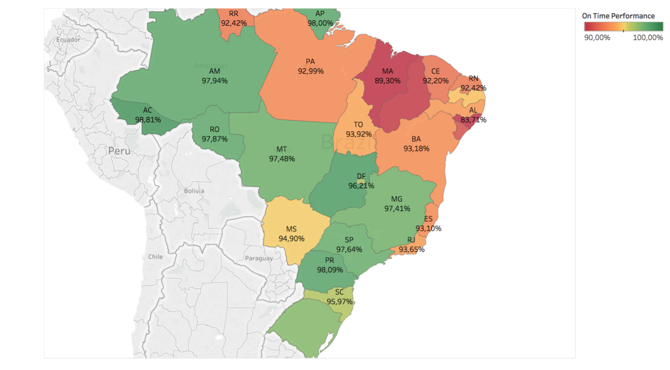
Recommendation 2: Are Distribution Centers Well Located? State Performance Map
These northeastern states have the weakest delivery times in Brazil. This therefore is a region that we believe Olist needs to focus on.

Slide 17
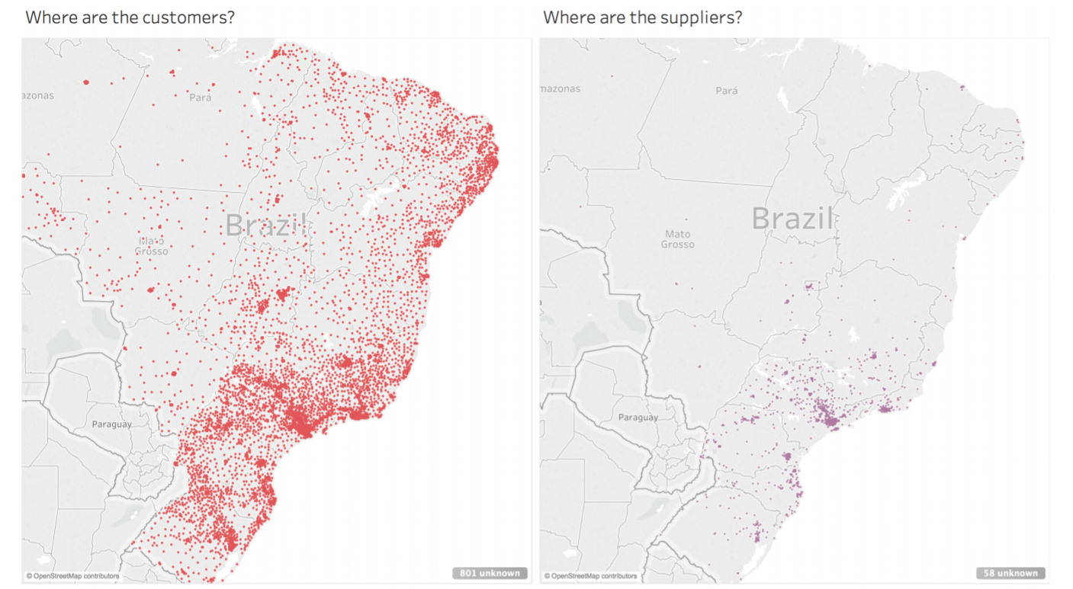
Recommendation 2: Are Distribution Centers Well Located? Where are the customers vs the sellers?
Mismatch between seller location and customer concentration in the northeast points to an opportunity for improvement

Slide 18
Recommendation 2: Are Distribution Centers Well Located? Delivery time

Slide 19
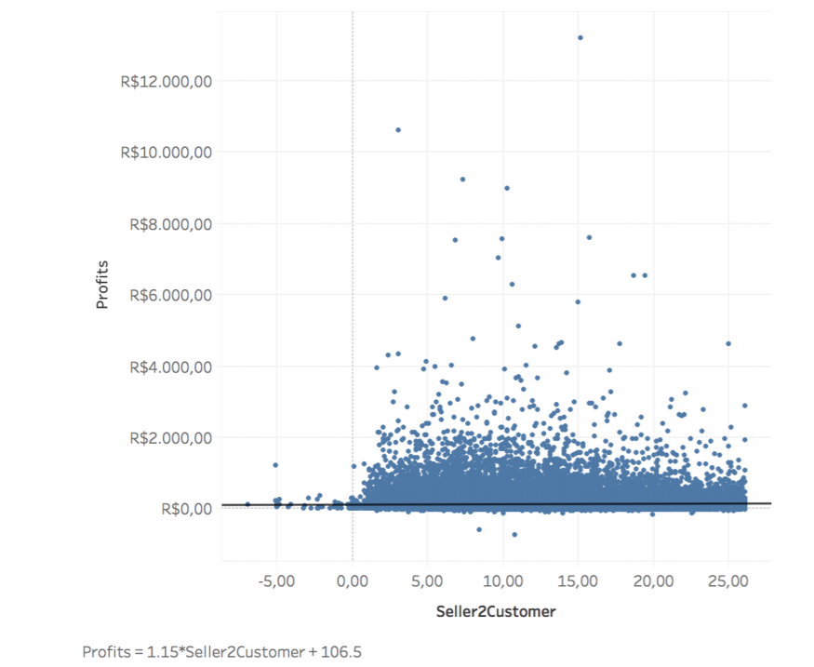
Recommendation 2: Are Distribution Centers Well Located? Profits and Speed of Delivery
Logical slight positive correlation between profits and speed of delivery
While it might not seem like much if we cut down to less than 10 days (3-4 days to give to carrier and 3-4 days to deliver to customers) and we get accuracy up to 90%+ like in the south, revenues in the north can triple, from 1.5M to 4.5M

Slide 20
Conclusion & Further Investigations
Conclusion
Goal
Recommendation 1
Recommendation 2
The objective of Olist is to remain the top retailer in Brazil and be ready to compete against multinationals like Amazon which are entering the country
Advertise with billboards in crowded arears of the populated states to increase public awareness of the brand
Target advertising on social media in less populated states
Contact and open distribution centers I the north to reach new customer base
This will increase on time performance and cut down delivery time and profits in the north could up to triple
Further Investigation
If we had had access to what products were stored where we could have run an analysis and looked at whether the correct sellers were in the correct state
The data goes from September 2016 to August 2018
With all 3 years of data some forecasting could have been done in order to understand what sales will look like in the next years
With more details about the products, rather than the category of products, we could have performed a lift analysis and see if there is a relationship between various products to understand what to bundle and how

Slide 21
Thank you for listening, Any Questions?

Slide 22
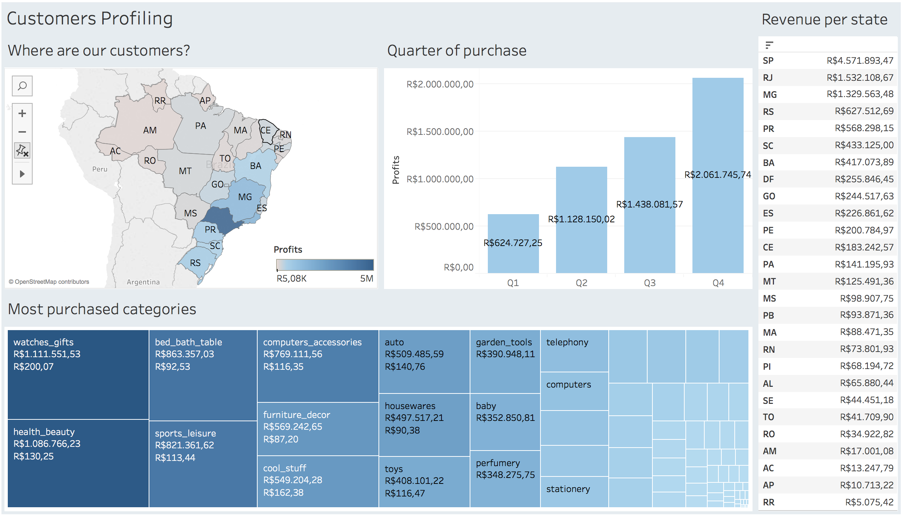
Appendix 1: Customer Profiling Dashboard

Slide 23
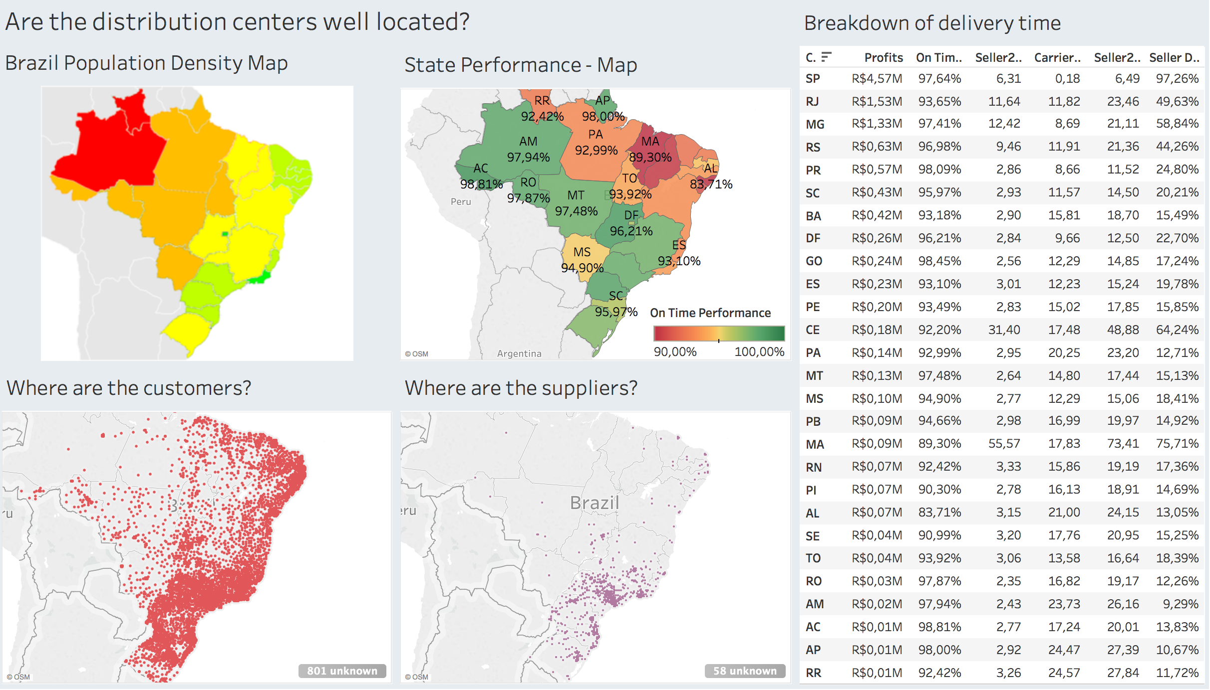
Appendix 2: Are Distribution Centers Well Located?

